Slide 1

FINAL REVIEW — IMPLEMENTATION & RESULTS
VeriSelf
Neutralizing AI Threats to Personal Privacy
Privacy-focused digital identity protection platform helping ordinary people detect and respond to unauthorized use, manipulation, or deepfake exposure of their photos and videos
TEAM MEMBERS :
PROJECT GUIDE :
Keerthivasan N
Dr. Ulaga Priya K
Saiganesh M
Dept. of Computer Science and Engineering (AI & ML)
Vels Institute of Science, Technology & Advanced Studies (VISTAS), Chennai
Ajay Kumar S

Slide 2
Introduction
A person does not need to be famous to become a target. A publicly available photograph can be copied, digitally altered, used in a fake profile, inserted into misleading content, or combined with artificial intelligence to create a manipulated image or video. Existing identity-protection tools focus mainly on passwords, credit records, or breach alerts — VeriSelf extends protection to a person's visual identity and digital media presence, offering authorized public-web monitoring, AI-assisted detection, confidence-scored alerts, and guided reporting or takedown support.
ID
Ordinary users are an easy,
under-protected target
Existing Tools vs. VeriSelf
Beyond Celebrities
Existing Identity Tools
VeriSelf
Anyone's face can be copied, morphed, or deepfaked — not just public figures.
Passwords & credentialsCredit-record
monitoring Alerts only after breach
Photos & videos of your face
Face misuse & impersonation
Proactive monitoring + alerts
Manual Search Fails
The same content resurfaces under different names, crops, or edits, too fast to track by hand.
Reactive Protection
Current tools alert only after breaches of passwords or credit data, not visual media.

Slide 3
Abstract
Personal photographs shared online can be copied, misused for impersonation, or altered without the owner's permission, leaving individuals with limited ways to investigate suspicious content and organize supporting evidence. VeriSelf is a full-stack web application developed to support personal digital identity protection through image analysis, identity verification, public-web monitoring, and evidence management. The system uses React and Vite to provide the user interface, FastAPI to handle backend operations, and SQLAlchemy with SQLite to manage application records. For identity verification, it employs MTCNN for face detection and an InceptionResnetV1 model pretrained on VGGFace2 to generate facial embeddings for comparison. Perceptual hashing helps identify visually similar images, while image and video analysis modules examine characteristics such as noise inconsistency, edge density, texture variation, and colour-channel differences to identify potential manipulation indicators. The monitoring module scans a user-specified public webpage for candidate images, and the evidence module organizes investigation findings for further review. Additional functions support photograph protection, risk assessment, alerts, and the preparation of draft legal-response notices. By bringing these capabilities together, VeriSelf provides a structured workflow for examining suspected digital identity misuse and documenting relevant findings. Its results require human review because facial similarity does not guarantee identity, perceptual matching cannot establish ownership, and heuristic forensic indicators alone cannot confirm image or video manipulation.
Digital Identity Defense
Deepfake Detection
AI Impersonation Shield

Slide 4
Literature Survey
Author & Title | Methodology | Limitation | Our Contribution to Overcome It
Ruiz et al. Disrupting Deepfakes (ECCV Wksp 2020) | Gradient-based imperceptible perturbation added directly to the image to distort GAN-based facial edits | Element-wise addition causes visible artifacts; not designed for face-swapping attacks | VeriSelf embeds forensic detection indicators so protection does not rely only on a fragile perturbation
Huang et al. Initiative Defense (AAAI 2021) | Surrogate model imitates Deepfake manipulation to craft a poison perturbation for injection | Needs grey-box surrogate models; largely fails to nullify real face swapping (similarity stays ~0.9) | Authorized web-monitoring flags misuse after the fact, independent of fooling any one swap model
Wang et al. Anti-Forgery (IJCAI 2022) | Adds perturbation to Lab color-space channels for better human-eye imperceptibility | Requires attribute information not always available; still fails to nullify face swapping | Forensic image/video indicators flag manipulated content regardless of source robustness
Huang et al. CMUA-Watermark (AAAI 2022) | Cross-model universal adversarial watermark generalized across multiple Deepfake models | White-box training assumption; heavy compute; identity similarity remains high after attack | VeriSelf's monitoring & alert pipeline needs no access to the target generative model at all
Qu et al. DF-RAP (2024) | Compression-approximation GAN sub-module models OSN compression to persist protection | Effective mainly against SimSwap only; poor generalization to other swapping models | Fingerprinting + perceptual comparison detect misuse irrespective of which swap model produced it
Rössler et al. FaceForensics++ (ICCV 2019) | Benchmark dataset with baseline CNNs for passive manipulated-facial-image detection | Passive detection only — no user registration, monitoring, alerting, or takedown workflow | VeriSelf builds on such detectors but adds the full register → monitor → alert → takedown lifecycle

Slide 5
System Architecture
Browser-first, privacy-preserving evidence pipeline with optional backend
Protect locally
Face + landmark scan
Upload source
photo
Browser working
copy
Forensic indicators
Case evidence
JSON
Human-reviewed
response draft
SHA-256 evidence
Perceptual verification
Candidate
comparison
SQLite + SQLAlchemy
Optional backend
registration
FastAPI
Backend comparison
Backend evidence

Slide 6
Base Paper
NullSwap: Proactive Identity Cloaking Against Deepfake Face Swapping — Wang et al., ICCV 2025
Contributions
Methodology
First to argue for protecting the SOURCE identity in face swapping, not the target image
First proactive method to nullify face swapping in a pure black-box setting (no generative model in training)
Novel Dynamic Loss Weighting (DLW) to adaptively balance identity losses across multiple face-recognition tools
Identity Extraction module (ConvBlock + SEResBlocks) captures dominant identity features
Perturbation Block generates identity-guided perturbation with adaptive random noise
Feature + Cloaking Blocks embed the perturbation at feature level to preserve visual quality
Trained against ArcFace & FaceNet using MSE + LPIPS + discriminator loss, weighted by DLW
Dataset
Limitations
CelebA-HQ — 30,000 high-quality facial images, 6,217 identities (train / val / test split)
LFW — 5,749 identities used for cross-dataset generalization validation
Images resized to 256×256; trained 60 epochs on 8 Tesla A100 GPUs, batch size 256
Purely proactive — only protects images cloaked BEFORE upload; cannot help photos already online
Targets face-swapping deepfakes only, not morphs, fake profiles, or reposted media generally
No detection, monitoring, alerting, or takedown mechanism once misuse actually occurs
No workflow for a non-technical, ordinary user to register, track, or act on violations

Slide 7
List of Modules
Seven modules, matching the system architecture
# | Module | Function | Key technology | Status
M1 | Local Protection | Apply protection to the browser working copy | Browser, client-side | Completed
M2 | Face + Landmark Scan | Detect the face and map landmarks | Face detection, landmarks | Completed
M3 | Forensic Indicators | Compute manipulation indicators | Forensic analysis | Completed
M4 | SHA-256 Evidence | Tamper-evident hash of the image | SHA-256 | Completed
M5 | Perceptual Verification & Comparison | Compare against candidate images | Perceptual hashing | Completed
M6 | Case Evidence & Response | Bundle evidence; draft response for human review | Case evidence JSON | Completed
M7 | Optional Backend | Register, store and compare on server | FastAPI, SQLite + SQLAlchemy | Completed

Slide 8
Module Diagrams — Client-Side Analysis
Runs in the browser on the working copy of the uploaded photo
M1
Local Protection
M2
Face + Landmark Scan
INPUT
PROCESS
OUTPUT
INPUT
PROCESS
OUTPUT
Source photo
Browser working copy → protect locally
Protected copy
Working copy
Detect face, map landmarks
Face region + landmark data
Client-side; backend is optional
Feeds the case evidence
M3
Forensic Indicators
M4
SHA-256 Evidence
INPUT
PROCESS
OUTPUT
INPUT
PROCESS
OUTPUT
Working copy
Run forensic checks
Indicator scores
Working copy
Compute SHA-256
Tamper-evident hash record
Indicators, not a "confirmed fake" verdict
Proves the file was not altered

Slide 9
Module Diagrams — Evidence & Backend
Perceptual comparison, case evidence and the optional server side
M5
Perceptual Verification & Comparison
M6
Case Evidence & Response
INPUT
PROCESS
OUTPUT
INPUT
PROCESS
OUTPUT
Working copy + candidate
Perceptual verification, candidate comparison
Similarity result
Indicators, hash, similarity
Assemble case evidence JSON
Human-reviewed response draft
Runs against candidate images
A person reviews before anything is sent
M7
Optional Backend (FastAPI)
Optional backend registration
FastAPI
SQLite + SQLAlchemy
Backend comparison + evidence
Server-side registration, storage and comparison

Slide 10
M1 — Local Protection
Applies protection to the browser working copy
Purpose
INPUT
Protect the user's photo locally before it is shared, so the original never has to leave the device.
Source photo
How it works
The uploaded JPG / PNG / WebP is handled as a browser working copy.
Protection is applied client-side to create a protected comparison image.
The backend is optional for this step.
PROCESS
Browser working copy → protect locally
Output
Protected copy of the photo.
Technology: browser, client-side processing.
OUTPUT
Protected copy
Client-side; backend is optional

Slide 11
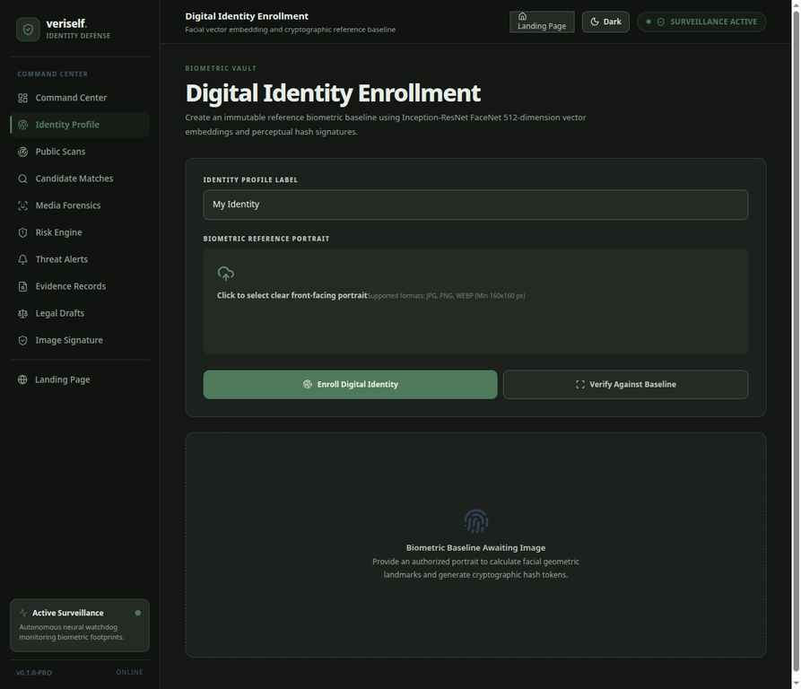
M2 — Face + Landmark Scan
Detects the face and maps landmarks
Purpose
Locate the face and produce the identity data used by the other modules.
How it works
Detects the face, measures detection confidence, draws the face box and marks facial landmark references.
MTCNN performs face detection; an InceptionResnetV1 model pretrained on VGGFace2 generates the facial embeddings (512-d) used for enrollment and comparison.
Output
Face region + landmark data and an identity embedding; feeds the case evidence.
Fig. Identity Enrollment — biometric reference baseline

Slide 12
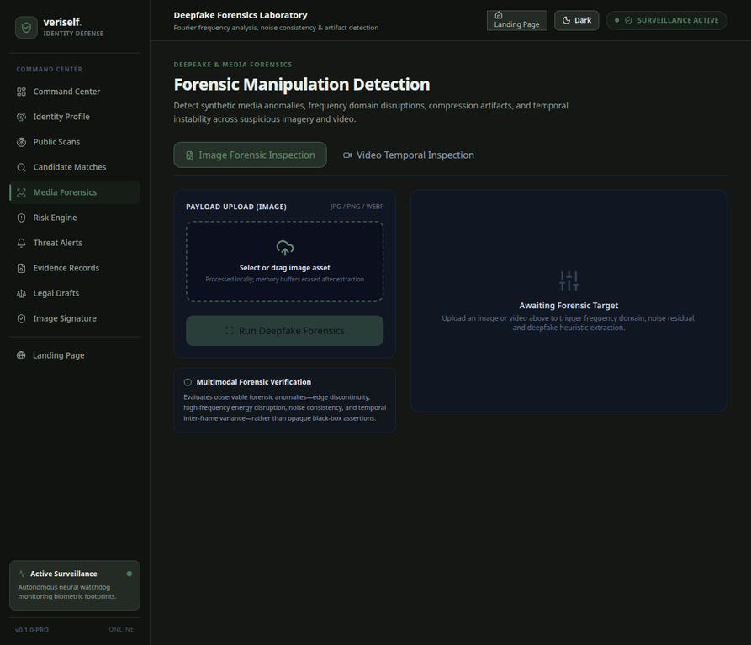
M3 — Forensic Indicators
Computes manipulation indicators
Purpose
Compute forensic indicators of possible manipulation for images and videos.
How it works
Measures edge variance (Laplacian), colour-channel drift and texture signal.
Image and video analysis also examine noise inconsistency and edge density; the interface offers Image Forensic Inspection and Video Temporal Inspection.
Output
Indicator scores. These are heuristic indicators, not a "confirmed fake" verdict.
Fig. Media Forensics — image and video inspection

Slide 13

M4 — SHA-256 Evidence
Tamper-evident hash of the image
Purpose
Create a tamper-evident record of the analysed file
How it works
Computes the SHA-256 hash of the image; any change to the file changes the hash.
Hash records are kept in the evidence logs (integrity proof with SHA-256).
Output
Tamper-evident hash record that shows the file was not altered.
Fig. Evidence Records — cryptographic evidence vault

Slide 14
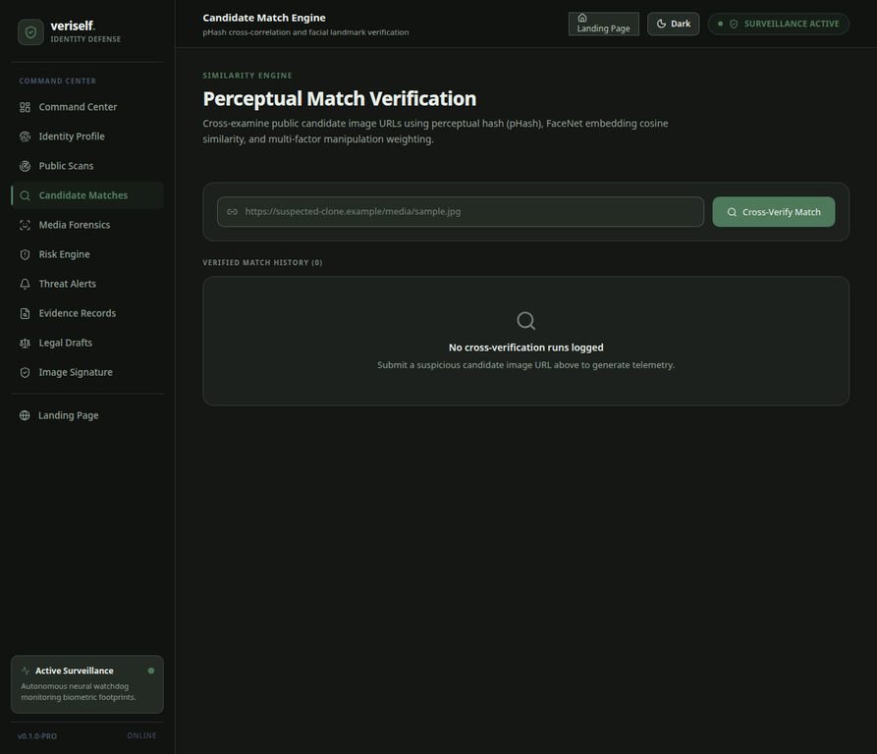
M5 — Perceptual Verification & Comparison
Compares the source against candidate images
Purpose
Find and score visually similar candidate images.
How it works
Compares 64-bit perceptual hashes using Hamming distance and a similarity percentage (0–8 bits = close perceptual match; > 8 bits = more visually distinct).
The application also cross-checks FaceNet embedding cosine similarity, and the monitoring module scans a user-specified public webpage for candidate images.
Output
Similarity result. Facial similarity does not guarantee identity; perceptual matching cannot establish ownership.
Fig. Candidate Matches — perceptual match verification

Slide 15
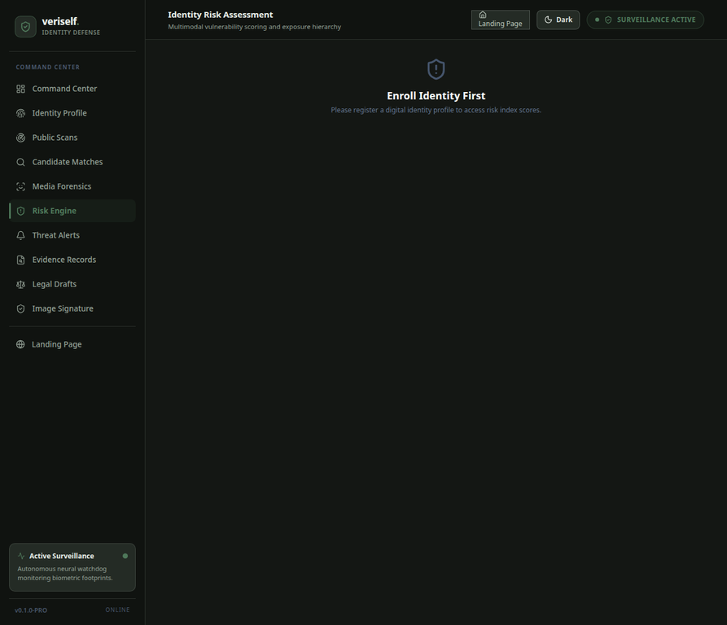
M6 — Case Evidence & Response
Bundles evidence and drafts a response for human review
Purpose
Organise the findings of an investigation for further review.
How it works
Indicators, hash and similarity are assembled into a case evidence JSON.
Supporting functions: risk assessment, alerts and draft legal-response notices.
Output
Human-reviewed response draft — a person reviews before anything is sent.
Fig. Risk Engine — identity risk assessment

Slide 16
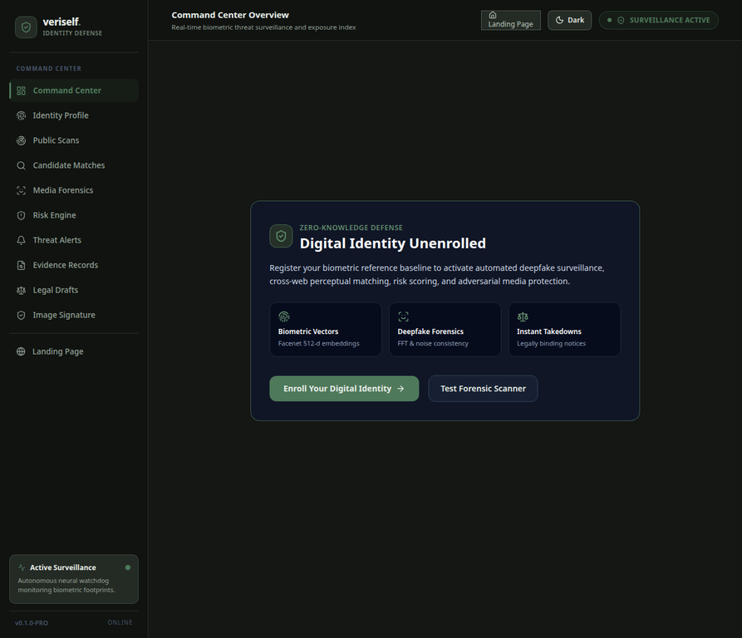
M7 — Optional Backend
Registers, stores and compares on the server
Purpose
Provide optional server-side registration, storage and comparison.
How it works
FastAPI handles the backend operations; SQLAlchemy with SQLite manages the application records.
React and Vite provide the user interface.
Output
Backend comparison and backend evidence.
Fig. Command Center — full-stack application overview

Slide 17
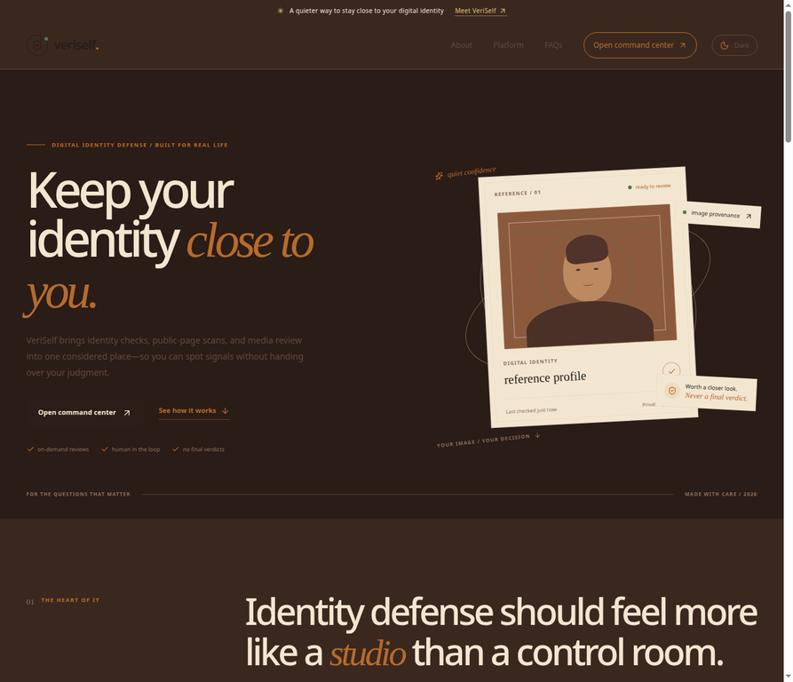
Results — Output Screenshots (1 of 4)
Screens captured from the VeriSelf web application (React + Vite front end)
Landing Page
Command Center
Entry page: "Keep your identity close to you" — on-demand reviews, human in the loop, no final verdicts.
Overview with Active Surveillance status; entry points for identity enrollment and the forensic scanner.

Slide 18
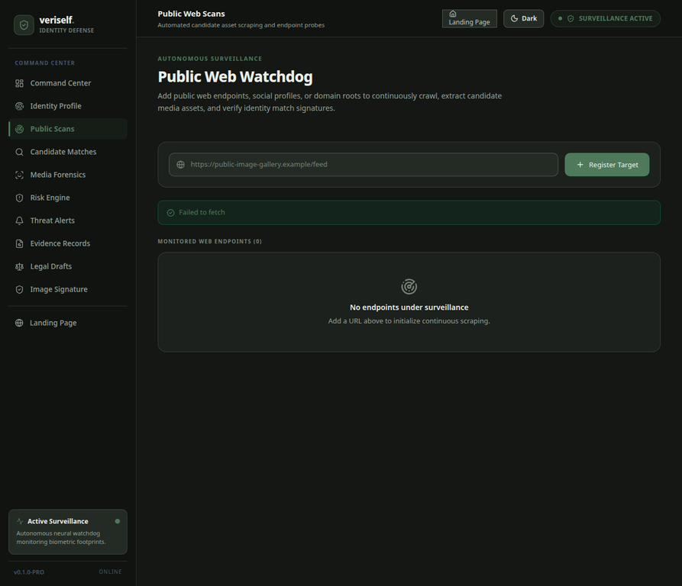
Results — Output Screenshots (2 of 4)
Screens captured from the VeriSelf web application (React + Vite front end)
Identity Enrollment
Public Web Scans
Enrolls a front-facing reference portrait (JPG / PNG / WebP) as an FaceNet 512-d embedding + perceptual hash baseline.
Registers a public web endpoint to crawl for candidate media; shows the monitored-endpoint list.

Slide 19
Results — Output Screenshots (3 of 4)
Screens captured from the VeriSelf web application (React + Vite front end)
Candidate Matches
Media Forensics
Cross-verifies a candidate image URL with pHash, FaceNet cosine similarity and manipulation weighting.
Image Forensic Inspection and Video Temporal Inspection with upload panel for the forensic target.

Slide 20
Results — Output Screenshots (4 of 4)
Screens captured from the VeriSelf web application (React + Vite front end)
Risk Engine
Evidence Records
Identity risk assessment; requires an enrolled identity profile before scores are shown.
Cryptographic evidence vault with SHA-256 integrity proofs; requires an enrolled identity.

Slide 21
Results Summary & Evaluation
Outputs Achieved
Evaluation
All seven modules (M1–M7) are implemented and completed
Full-stack web application: React + Vite interface, FastAPI backend, SQLAlchemy + SQLite records
Identity enrollment with MTCNN face detection and InceptionResnetV1 (VGGFace2) embeddings
Perceptual-hash match verification with Hamming distance and similarity percentage
Image and video forensic indicators; SHA-256 evidence records
Public-web monitoring, risk assessment, alerts and draft legal-response notices
Sample perceptual-hash check (64-bit): e38a29b4c0f1d5e6 vs e38a29b4c0f1d5a1 differ in 4 bits (Hamming distance 4), inside the 0–8 bit "close perceptual match" band
Forensic outputs are reported as indicators (Laplacian variance, channel drift, texture signal) — never as a "confirmed fake" verdict
Results require human review: facial similarity does not guarantee identity, perceptual matching cannot establish ownership, and heuristic indicators cannot confirm manipulation

Slide 22
VeriSelf brings photograph protection, identity verification, public-web monitoring, forensic analysis and evidence management into one structured workflow
It extends protection from passwords and credit records to a person's visual identity
Every result is positioned as a lead for human review, supported by tamper-evident evidence, rather than a final verdict
Conclusion & Future Scope
Conclusion :
Future Scope :
Audio deepfake / voice-clone detection, to protect against forged or cloned voice content alongside images and video
Full CNN–LSTM temporal analysis for video (beyond the first-version temporal-pooling baseline)
FAISS-based large-scale embedding search across many authorized sources for broader monitoring coverage
Automated takedown-request drafting and submission, with user review and approval before sending
Mobile app with real-time push notifications for high-confidence alerts
Multi-language support for reporting and takedown channels across regions

Slide 23
References — Research Papers
[1] Wang et al., "NullSwap: Proactive Identity Cloaking Against Deepfake Face Swapping," in Proc. IEEE/CVF International Conference on Computer Vision (ICCV), 2025.
[2] N. Ruiz, S. A. Bargal and S. Sclaroff, "Disrupting Deepfakes: Adversarial Attacks Against Conditional Image Translation Networks and Facial Manipulation Systems," in ECCV Workshops, 2020.
[3] Huang et al., "Initiative Defense against Facial Manipulation," in Proc. AAAI Conference on Artificial Intelligence, 2021.
[4] Wang et al., "Anti-Forgery: Towards a Stealthy and Robust DeepFake Disruption Attack via Adversarial Perceptual-aware Perturbations," in Proc. International Joint Conference on Artificial Intelligence (IJCAI), 2022.
[5] Huang et al., "CMUA-Watermark: A Cross-Model Universal Adversarial Watermark for Combating Deepfakes," in Proc. AAAI Conference on Artificial Intelligence, 2022.
[6] Qu et al., "DF-RAP: A Robust Adversarial Perturbation for Defending Against Deepfakes in Real-World Social Network Scenarios," IEEE Transactions on Information Forensics and Security, vol. 19, pp. 3943–3957, 2024.
[7] A. Rössler, D. Cozzolino, L. Verdoliva, C. Riess, J. Thies and M. Nießner, "FaceForensics++: Learning to Detect Manipulated Facial Images," in Proc. IEEE/CVF International Conference on Computer Vision (ICCV), 2019.

Slide 24
References — Technologies Used
[8] K. Zhang, Z. Zhang, Z. Li and Y. Qiao, "Joint Face Detection and Alignment Using Multitask Cascaded Convolutional Networks," IEEE Signal Processing Letters, vol. 23, no. 10, pp. 1499–1503, 2016.
[9] C. Szegedy, S. Ioffe, V. Vanhoucke and A. Alemi, "Inception-v4, Inception-ResNet and the Impact of Residual Connections on Learning," in Proc. AAAI Conference on Artificial Intelligence, 2017, pp. 4278–4284.
[10] Q. Cao, L. Shen, W. Xie, O. M. Parkhi and A. Zisserman, "VGGFace2: A Dataset for Recognising Faces across Pose and Age," in Proc. IEEE International Conference on Automatic Face & Gesture Recognition (FG), 2018, pp. 67–74.
[11] F. Schroff, D. Kalenichenko and J. Philbin, "FaceNet: A Unified Embedding for Face Recognition and Clustering," in Proc. IEEE Conference on Computer Vision and Pattern Recognition (CVPR), 2015, pp. 815–823.
[12] National Institute of Standards and Technology, "Secure Hash Standard (SHS)," FIPS PUB 180-4, 2015.
[13] FastAPI documentation. [Online]. Available: https://fastapi.tiangolo.com
[14] SQLAlchemy documentation. [Online]. Available: https://www.sqlalchemy.org
[15] React documentation. [Online]. Available: https://react.dev; Vite documentation. [Online]. Available: https://vite.dev

